Slide 1
MA3077 (DLI) Operational Research Lecture 10&11– Networks
Dr Neslihan Suzen

Slide 2
Recap and lecture outline
Summary: We have learnt:
about sensitivity analysis
how to model mixed-integer linear programming problems,
and how to solve them in Matlab using intlinprog.
Today: Networks, following loosely Ch. 10 of the book by Hillier and Lieberman.

Slide 3
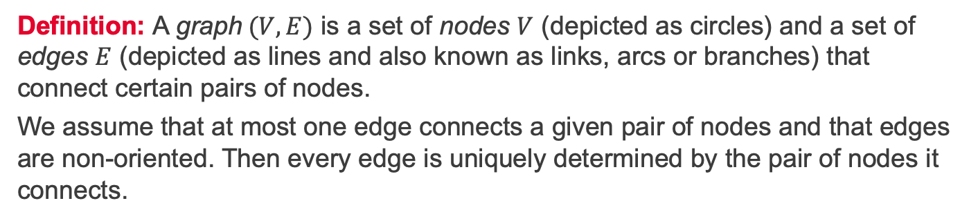
Graphs, nodes, and edges
A
T
B
D
O
C
E
Definition: A graph$(V,E)$ is a set of nodes $V$ (depicted as circles) and a set of edges $E$ (depicted as lines and also known as links, arcs or branches) that connect certain pairs of nodes.
We assume that at most one edge connects a given pair of nodes and that edges are non-oriented. Then every edge is uniquely determined by the pair of nodes it connects.

Slide 4
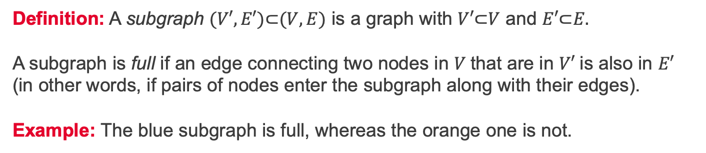
Subgraphs and full subgraphs
A
T
B
D
O
C
E
Definition: A subgraph $(V′,E′)\text{⊂}(V,E)$ is a graph with $V′\text{⊂}V$ and $E′\text{⊂}E.$ A subgraph is full if an edge connecting two nodes in $V$that are in $V′$is also in $E′$ (in other words, if pairs of nodes enter the subgraph along with their edges). Example: The blue subgraph is full, whereas the orange one is not.

Slide 5
Paths and cycles
A
T
B
D
O
C
E
Definitions:
Two edges are connected if adjacent to a common node
A path is a (unique) sequence of connected edges with each node being adjacent to at most two edges in the path (e.g. blue line)
A cycle is a path that begins and ends at the same node (e.g. orange line).

Slide 6
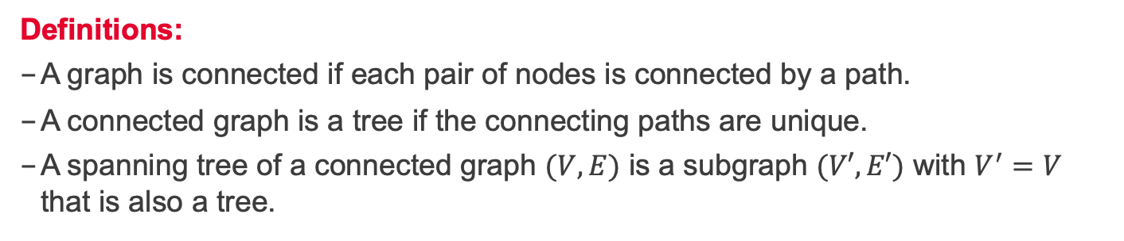
Connected graphs and trees
A
T
B
D
O
C
E
Definitions:
A graph is connected if each pair of nodes is connected by a path.
A connected graph is a tree if the connecting paths are unique.
A spanning tree of a connected graph $(V,E)$ is a subgraph $(V′,E′)$ with $V^{′}=V$ that is also a tree.

Slide 7
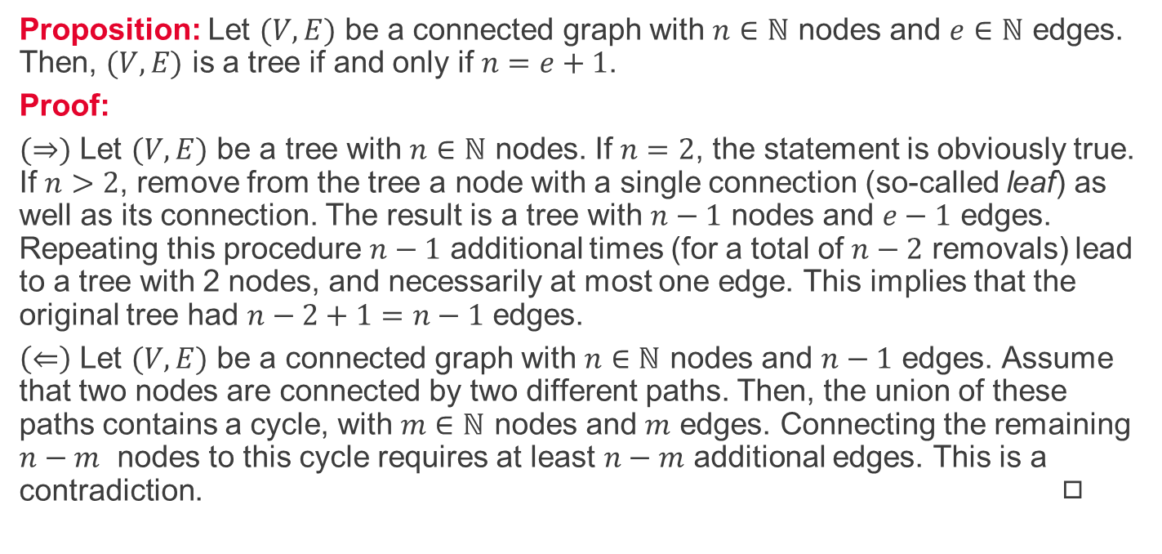
Euler formula for trees
Proposition: Let $(V,E)$ be a connected graph with $n∈ℕ$ nodes and $e∈ℕ$ edges. Then, $(V,E)$ is a tree if and only if $n=e+1$.
Proof:
$(⇒)$ Let $(V,E)$ be a tree with $n∈ℕ$ nodes. If $n=2$, the statement is obviously true. If $n>2$, remove from the tree a node with a single connection (so-called leaf) as well as its connection. The result is a tree with $n−1$ nodes and $e−1$ edges. Repeating this procedure $n−1$ additional times (for a total of $n−2$ removals) lead to a tree with 2 nodes, and necessarily at most one edge. This implies that the original tree had $n−2+1=n−1$ edges.
$\left(⇐\right)$ Let $(V,E)$ be a connected graph with $n∈ℕ$ nodes and $n−1$ edges. Assume that two nodes are connected by two different paths. Then, the union of these paths contains a cycle, with $m∈ℕ$ nodes and $m$ edges. Connecting the remaining $n−m$ nodes to this cycle requires at least $n−m$ additional edges. This is a contradiction. ◻︎

Slide 8
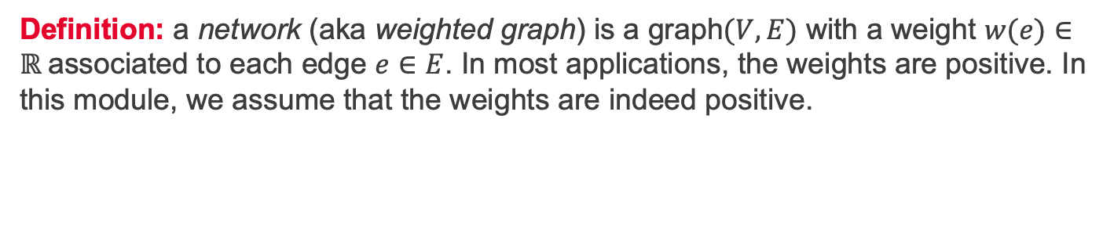
Networks
A
7
2
2
5
T
5
4
B
D
O
1
1
3
7
4
C
3
E
Definition: a network (aka weighted graph) is a graph$(V,E)$ with a weight $w(e)∈ℝ$associated to each edge $e∈E$. In most applications, the weights are positive. In this module, we assume that the weights are indeed positive.

Slide 9
Example of a network - scenario
A
7
2
2
5
T
5
4
B
D
O
1
1
3
7
4
C
3
E
Scenario: A park has a narrow, winding road system for trams (shown in the figure). Location O is the entrance into the park; other letters designate the locations of ranger stations (and other limited facilities). The numbers are lengths of roads in miles. The park contains a scenic wonder at station T. A small number of trams are used to transport sightseers from the park entrance to station T and back.

Slide 10
Example of a network – typical problems
A
7
2
2
5
T
5
4
B
D
O
1
1
3
7
4
C
3
E
Problem 1: The park manager wants to install telephone lines under the roads to establish telephone communication among all the stations. To reduce costs, lines will be installed under just enough roads to ensure every station is connected to the web. Where shall they lay the lines to minimize the total length of lines installed?
Problem 2: What is the shortest route from the entrance to the scenic station T?

Slide 11
Minimal spanning trees and shortest paths
A
7
2
2
5
T
5
4
B
D
O
1
1
3
7
4
C
3
E
Minimal spanning tree problem: Identify a connected subnetwork that contains all the nodes and such that the sum of the weights of the edges included (the total weight) is minimal.
Shortest path problem: Determine a path to join two nodes such that the sum of the weights of the edges included is minimal.

Slide 12
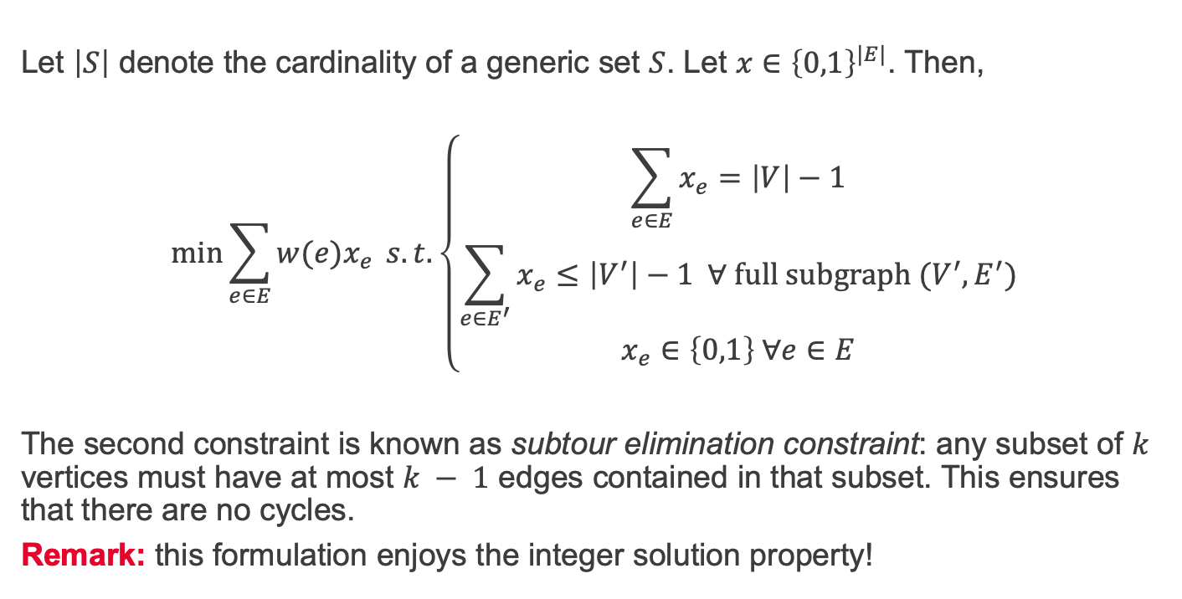
Minimal spanning tree via linear programming
Let $\left|S\right|$ denote the cardinality of a generic set $S$. Let $x∈{\left\{0,1\right\}}^{|E|}$. Then,
$$\min{\sum_{e∈E}{w(e)x_{e}} s.t. \left\{\begin{aligned}\sum_{e∈E}{x_{e}}=\left|V\right|−1 \\ \sum_{e∈E^{′}}{x_{e}}≤\left|V^{′}\right|−1 ∀ full subgraph (V^{′},E^{′}) \\ x_{e}∈\left\{0,1\right\} ∀e∈E\end{aligned}\right.}$$
The second constraint is known as subtour elimination constraint: any subset of $k$ vertices must have at most $k − 1$ edges contained in that subset. This ensures that there are no cycles.
Remark: this formulation enjoys the integer solution property!

Slide 13
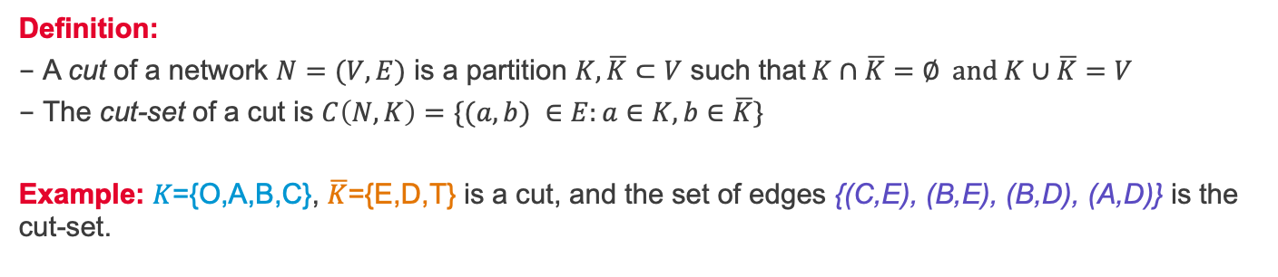
Network cuts
A
7
2
2
5
T
5
4
B
D
O
1
1
3
7
4
C
3
E
Definition:
A cut of a network $N=(V,E)$ is a partition $K, \overline{K}⊂V$ such that$K∩\overline{K}=∅ and K∪\overline{K}=V$
The cut-set of a cut is $C\left(N,K\right)=\{(a,b) ∈E:a∈K,b∈\overline{K}\}$
Example: 𝐾={O,A,B,C}, $\overline{K}$={E,D,T} is a cut, and the set of edges {(C,E), (B,E), (B,D), (A,D)} is the cut-set.

Slide 14
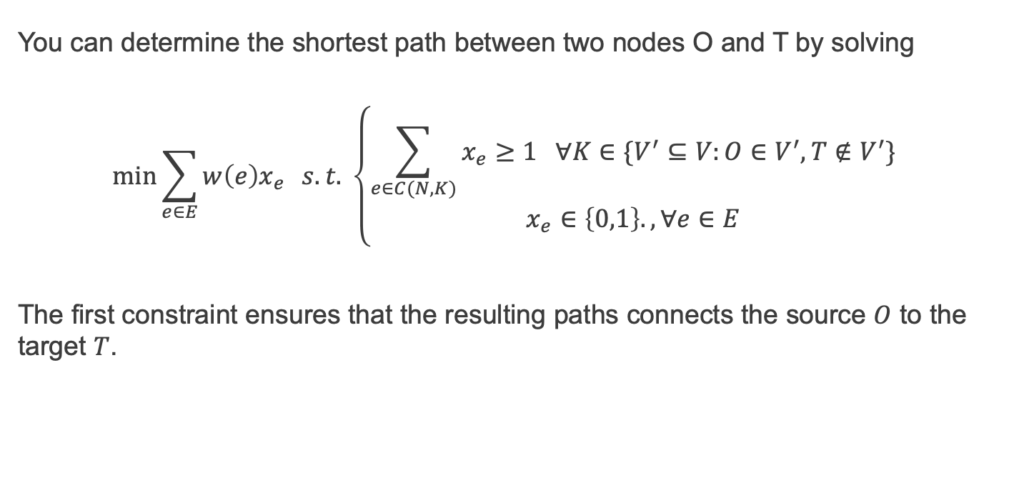
Shortest path via linear programming
You can determine the shortest path between two nodes O and T by solving
$$\min{\sum_{e∈E}{w\left(e\right)x_{e}}} s.t. \left\{\begin{aligned}\sum_{e∈C(N,K)}{x_{e}≥1 ∀K∈\{V^{′}⊆V:O∈V^{′}, T∉V^{′}\}} \\ x_{e}∈\left\{0,1\right\}., ∀e∈E\end{aligned}\right.$$
The first constraint ensures that the resulting paths connects the source $O$ to the target $T$.

Slide 15
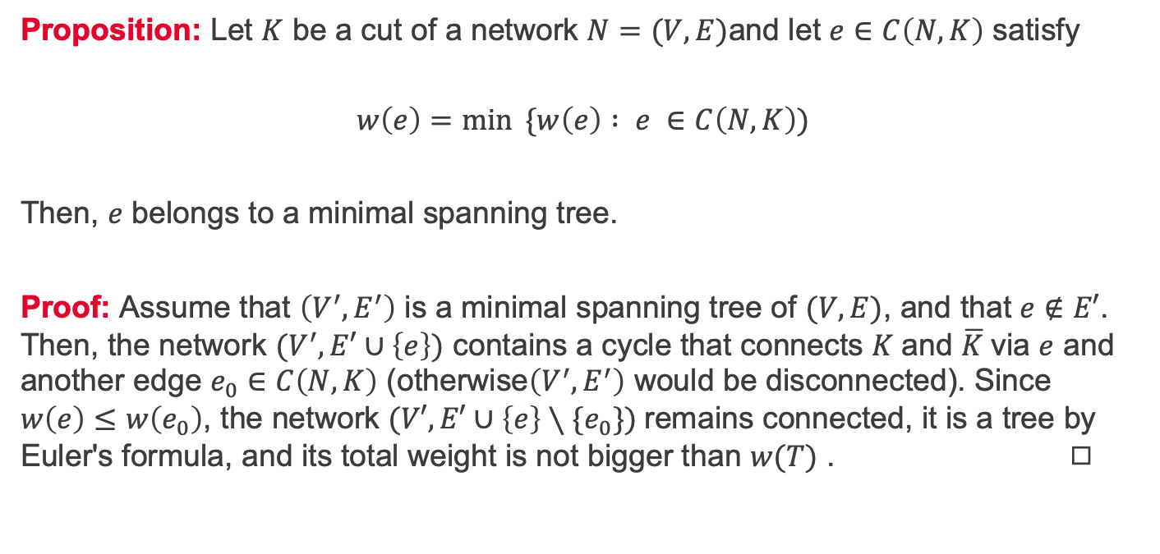
A key property of cuts
Proposition: Let $K$ be a cut of a network $N=(V,E)$and let $e∈C\left(N,K\right)$ satisfy
$$w\left(e\right)=\min{ \{w\left(e\right) : e }∈C\left(N,K\right))$$
Then, $e$ belongs to a minimal spanning tree.
Proof: Assume that $\left(V^{′}, E^{′}\right)$ is a minimal spanning tree of $(V,E)$, and that $e∉E′$. Then, the network $(V^{′}, E′∪\left\{e\right\})$ contains a cycle that connects $K$and $\overline{K}$via $e$ and another edge $e_{0}∈C\left(N,K\right)$ (otherwise$\left(V^{′}, E^{′}\right)$ would be disconnected). Since $w\left(e\right)≤w\left(e_{0}\right)$, the network $(V′, E′∪\left\{e\right\}∖\{e_{0}\})$remains connected, it is a tree by Euler's formula, and its total weight is not bigger than $w(T)$ . ◻︎

Slide 16
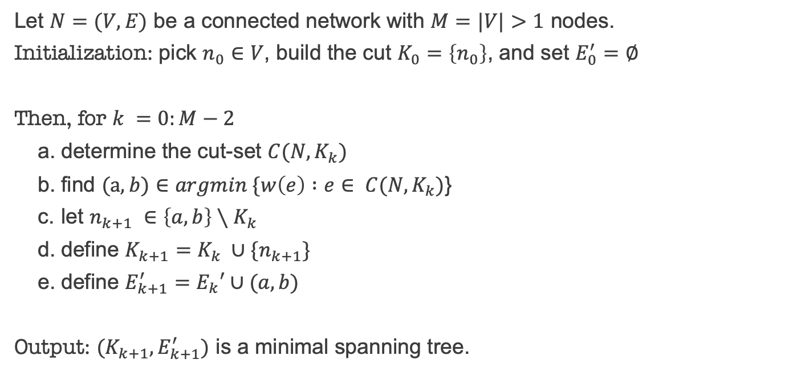
Prim's algorithm (1930, Jarník)
Let $N=(V,E)$ be a connected network with $M=|V|>1$ nodes.
Initialization: pick $n_{0}∈$ $V$, build the cut $K_{0}=\left\{n_{0}\right\}$, and set $E_{0}^{′}=∅$
Then, for $k =0:M−2$
determine the cut-set $C(N,K_{k})$
find $(a,b)∈argmin \{w\left(e\right) :e$ $∈ C(N,K_{k})$}
let $n_{k+1} ∈\left\{a,b\right\}∖K_{k}$
define $K_{k+1}=K_{k} ∪\{n_{k+1}\}$
define $E_{k+1}^{′}=E_{k}′∪(a,b)$
Output: $(K_{k+1}, E_{k+1}^{′})$ is a minimal spanning tree.

Slide 17
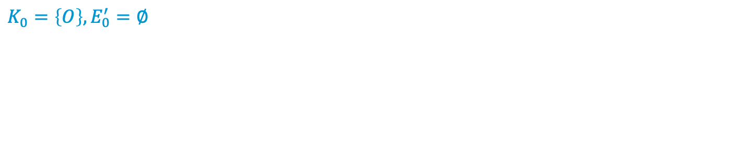
Prim's algorithm – example (step 1)
A
7
2
2
5
T
5
4
B
D
O
1
1
3
7
4
C
3
E
$$K_{0}=\left\{O\right\}, E_{0}^{′}=∅$$

Slide 18
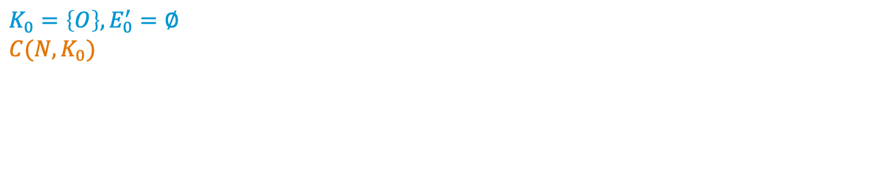
Prim's algorithm – example (step 2)
A
7
2
2
5
T
5
4
B
D
O
1
1
3
7
4
C
3
E
$$K_{0}=\left\{O\right\},E_{0}^{′}=∅ \\ C(N, K_{0})$$

Slide 19
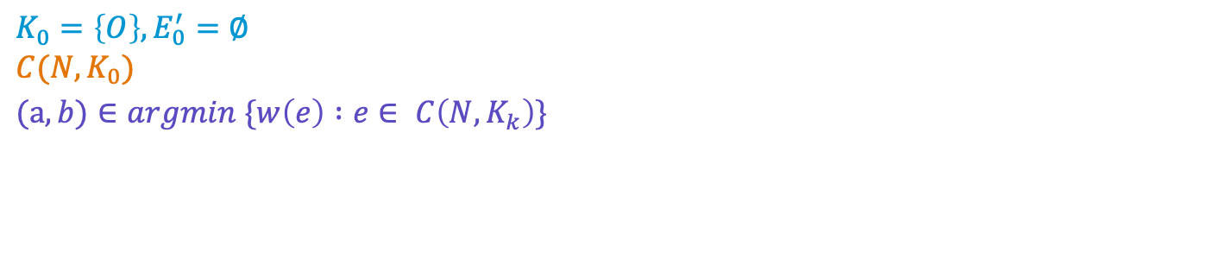
Prim's algorithm - example (step 3)
A
7
2
2
5
T
5
4
B
D
O
1
1
3
7
4
C
3
E
$$K_{0}=\left\{O\right\},E_{0}^{′}=∅ \\ C(N, K_{0})$$
$$(a,b)∈argmin \{w\left(e\right) :e∈ C\left(N,K_{k}\right)\}$$

Slide 20
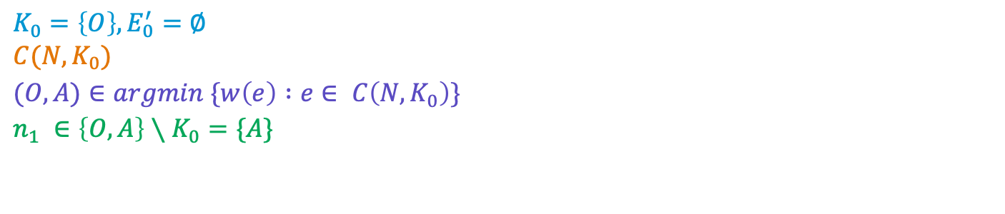
Prim's algorithm - example (step 4)
A
7
2
2
5
T
5
4
B
D
O
1
1
3
7
4
C
3
E
$$K_{0}=\left\{O\right\},E_{0}^{′}=∅ \\ C(N, K_{0})$$
$$(O,A)∈argmin \{w\left(e\right) :e∈ C\left(N,K_{0}\right)\}$$
$$n_{1} ∈\left\{O,A\right\}∖K_{0}=\{A\}$$

Slide 21
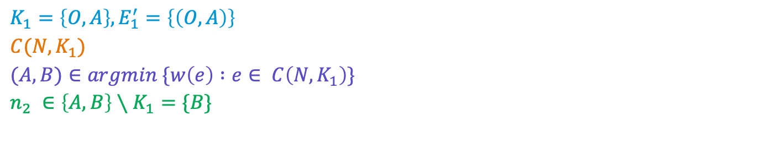
Prim's algorithm - example (step 5)
A
7
2
2
5
T
5
4
B
D
O
1
1
3
7
4
C
3
E
$$K_{1}=\left\{O,A\right\}, E_{1}^{′}=\left\{\left(O,A\right)\right\}$$
$$C(N, K_{1})$$
$$(A,B)∈argmin \{w\left(e\right) :e∈ C\left(N,K_{1}\right)\}$$
$$n_{2} ∈\left\{A,B\right\}∖K_{1}=\{B\}$$

Slide 22
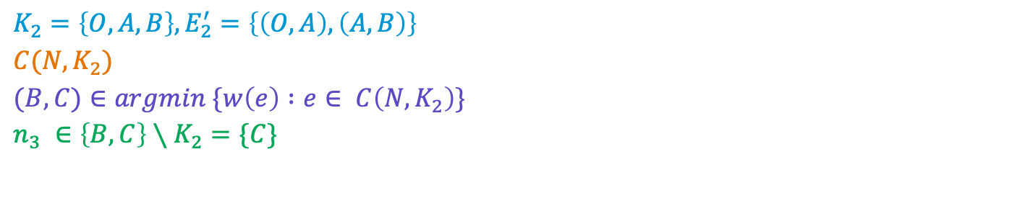
Prim's algorithm - example (step 6)
A
7
2
2
5
T
5
4
B
D
O
1
1
3
7
4
C
3
E
$$K_{2}=\left\{O,A,B\right\}, E_{2}^{′}=\left\{\left(O,A\right), \left(A,B\right)\right\}$$
$$C(N, K_{2})$$
$$(B,C)∈argmin \{w\left(e\right) :e∈ C\left(N,K_{2}\right)\}$$
$$n_{3} ∈\left\{B,C\right\}∖K_{2}=\{C\}$$

Slide 23
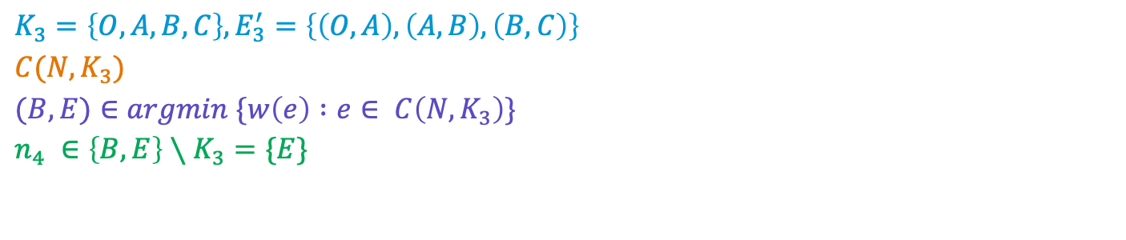
Prim's algorithm - example (step 7)
A
7
2
2
5
T
5
4
B
D
O
1
1
3
7
4
C
3
E
$$K_{3}=\left\{O,A,B,C\right\}, E_{3}^{′}=\left\{\left(O,A\right), \left(A,B\right),\left(B,C\right)\right\}$$
$$C(N, K_{3})$$
$$(B,E)∈argmin \{w\left(e\right) :e∈ C\left(N,K_{3}\right)\}$$
$$n_{4} ∈\left\{B,E\right\}∖K_{3}=\{E\}$$

Slide 24
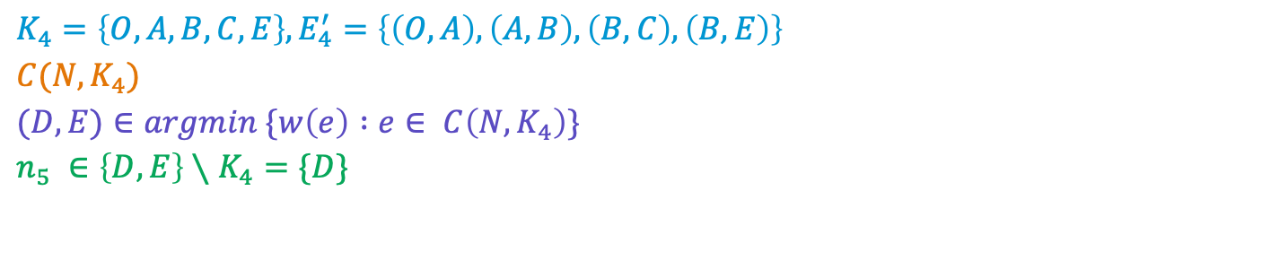
Prim's algorithm - example (step 8)
A
7
2
2
5
T
5
4
B
D
O
1
1
3
7
4
C
3
E
$$K_{4}=\left\{O,A,B,C,E\right\}, E_{4}^{′}=\left\{\left(O,A\right),\left(A,B\right),\left(B,C\right),\left(B,E\right)\right\}$$
$$C(N, K_{4})$$
$$(D,E)∈argmin \{w\left(e\right) :e∈ C\left(N,K_{4}\right)\}$$
$$n_{5} ∈\left\{D,E\right\}∖K_{4}=\{D\}$$

Slide 25
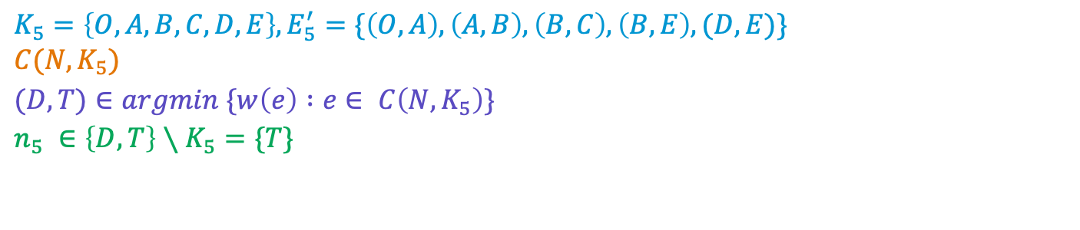
Prim's algorithm - example (step 9)
A
7
2
2
5
T
5
4
B
D
O
1
1
3
7
4
C
3
E
$$K_{5}=\left\{O,A,B,C,D,E\right\},E_{5}^{′}=\{\left(O,A\right), \left(A,B\right),\left(B,C\right),\left(B,E\right),(D,E)\} \\ C(N, K_{5})$$
$$(D,T)∈argmin \{w\left(e\right) :e∈ C\left(N,K_{5}\right)\}$$
$$n_{5} ∈\left\{D,T\right\}∖K_{5}=\{T\}$$

Slide 26
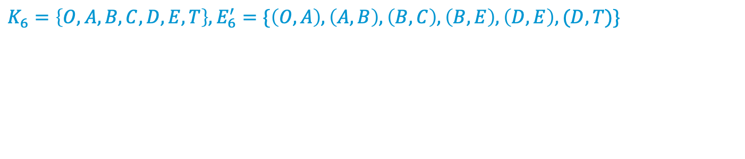
Prim's algorithm – example (step 10)
A
7
2
2
5
T
5
4
B
D
O
1
1
3
7
4
C
3
E
$$K_{6}=\left\{O,A,B,C,D,E,T\right\},E_{6}^{′}=\{\left(O,A\right), \left(A,B\right),\left(B,C\right),\left(B,E\right),\left(D,E\right),(D,T)\}$$

Slide 27
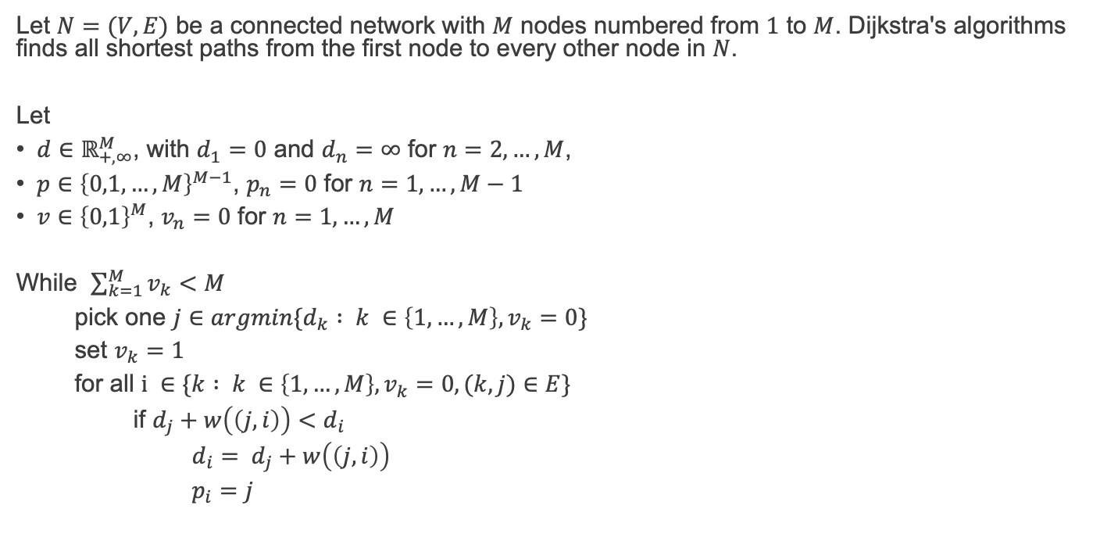
Dijkstra's algorithm (1956)
Let $N=(V,E)$ be a connected network with $M$ nodes numbered from $1$ to $M$. Dijkstra's algorithms finds all shortest paths from the first node to every other node in $N$.
Let
$d∈ℝ_{+,∞}^{M}$, with $d_{1}=0$ and $d_{n}=$ $∞$ for $n=2, …, M$,
$p∈{\left\{0,1, …, M\right\}}^{M−1}$, $p_{n}=$ $0$ for $n=1, …, M−1$
$v∈{\left\{0,1\right\}}^{M}$, $v_{n}=$ $0$ for $n=1, …, M$
While $\sum_{k=1}^{M}{v_{k}}<M$
pick one $j∈argmin\{d_{k} : k ∈\left\{1,…,M\right\}, v_{k}=0\}$
set $v_{k}=1$
for all $i ∈\{k : k ∈\left\{1,…,M\right\},v_{k}=0, (k,j)∈E\}$
if $d_{j}+w\left(\left(j,i\right)\right)<d_{i}$
$d_{i}= d_{j}+w\left(\left(j,i\right)\right)$
$p_{i}=j$

Slide 28
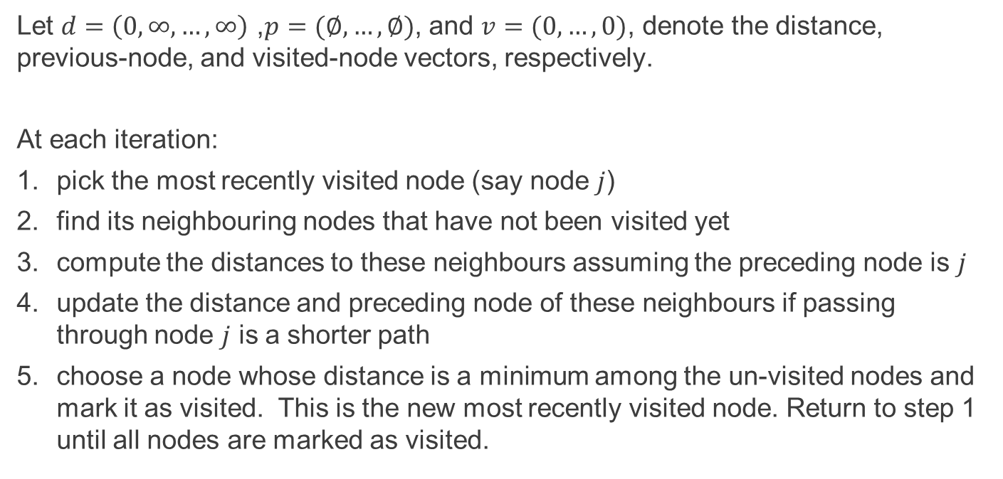
Dijkstra's algorithm (1956) in lay terms
Let $d=\left(0,∞,…,∞\right)$ ,$p=(∅, …, ∅)$, and $v=(0,…,0)$, denote the distance, previous-node, and visited-node vectors, respectively.
At each iteration:
pick the most recently visited node (say node $j$)
find its neighbouring nodes that have not been visited yet
compute the distances to these neighbours assuming the preceding node is $j$
update the distance and preceding node of these neighbours if passing through node $j$ is a shorter path
choose a node whose distance is a minimum among the un-visited nodes and mark it as visited. This is the new most recently visited node. Return to step 1 until all nodes are marked as visited.

Slide 29
Dijkstra's algorithm – example (step 1)
A
7
2
2
5
T
5
4
B
D
O
1
1
3
7
4
C
3
E
$\begin{matrix} & & d & p & v \\ O & 1 & 0 & & 0 \\ A & 2 & ∞ & 0 & 0 \\ B & 3 & ∞ & 0 & 0 \\ C & 4 & ∞ & 0 & 0 \\ D & 5 & ∞ & 0 & 0 \\ E & 6 & ∞ & 0 & 0 \\ T & 7 & ∞ & 0 & 0\end{matrix}$

Slide 30
Dijkstra's algorithm – example (step 2)
A
7
2
2
5
T
5
4
B
D
O
1
1
3
7
4
C
3
E
$\begin{matrix} & & d & p & v \\ O & 1 & 0 & & 0 \\ A & 2 & ∞ & 0 & 0 \\ B & 3 & ∞ & 0 & 0 \\ C & 4 & ∞ & 0 & 0 \\ D & 5 & ∞ & 0 & 0 \\ E & 6 & ∞ & 0 & 0 \\ T & 7 & ∞ & 0 & 0\end{matrix}$ $j∈argmin\left\{d_{k} : k ∈\left\{1,…,M\right\}, v_{k}=0\right\}=\left\{1\right\}$

Slide 31
Dijkstra's algorithm – example (step 3)
A
7
2
2
5
T
5
4
B
D
O
1
1
3
7
4
C
3
E
$\begin{matrix} & & d & p & v \\ O & 1 & 0 & & 1 \\ A & 2 & ∞ & 0 & 0 \\ B & 3 & ∞ & 0 & 0 \\ C & 4 & ∞ & 0 & 0 \\ D & 5 & ∞ & 0 & 0 \\ E & 6 & ∞ & 0 & 0 \\ T & 7 & ∞ & 0 & 0\end{matrix}$ $\begin{matrix}j∈argmin\left\{d_{k} : k ∈\left\{1,…,M\right\}, v_{k}=0\right\}=\left\{1\right\} \\ v_{j}=1\end{matrix}$

Slide 32
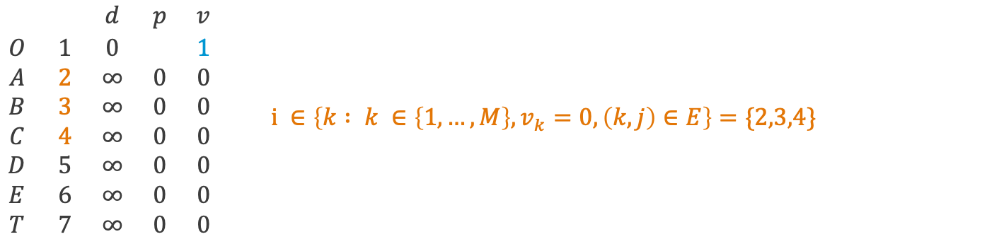
Dijkstra's algorithm – example (step 4)
A
7
2
2
5
T
5
4
B
D
O
1
1
3
7
4
C
3
E
$\begin{matrix} & & d & p & v \\ O & 1 & 0 & & 1 \\ A & 2 & ∞ & 0 & 0 \\ B & 3 & ∞ & 0 & 0 \\ C & 4 & ∞ & 0 & 0 \\ D & 5 & ∞ & 0 & 0 \\ E & 6 & ∞ & 0 & 0 \\ T & 7 & ∞ & 0 & 0\end{matrix}$ $i ∈\left\{k : k ∈\left\{1,…,M\right\},v_{k}=0, \left(k,j\right)∈E\right\}=\{2,3,4\}$

Slide 33
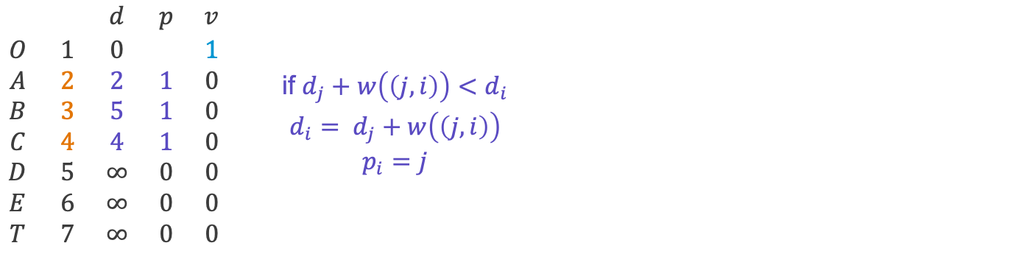
Dijkstra's algorithm – example (step 5)
A
7
2
2
5
T
5
4
B
D
O
1
1
3
7
4
C
3
E
$\begin{matrix} & & d & p & v \\ O & 1 & 0 & & 1 \\ A & 2 & 2 & 1 & 0 \\ B & 3 & 5 & 1 & 0 \\ C & 4 & 4 & 1 & 0 \\ D & 5 & ∞ & 0 & 0 \\ E & 6 & ∞ & 0 & 0 \\ T & 7 & ∞ & 0 & 0\end{matrix}$ $\begin{matrix}\text{if} d_{j}+w\left(\left(j,i\right)\right)<d_{i} \\ d_{i}= d_{j}+w\left(\left(j,i\right)\right) \\ p_{i}=j\end{matrix}$

Slide 34
Dijkstra's algorithm – example (step 6)
A
7
2
2
5
T
5
4
B
D
O
1
1
3
7
4
C
3
E
$\begin{matrix} & & d & p & v \\ O & 1 & 0 & & 1 \\ A & 2 & 2 & 1 & 0 \\ B & 3 & 5 & 1 & 0 \\ C & 4 & 4 & 1 & 0 \\ D & 5 & ∞ & 0 & 0 \\ E & 6 & ∞ & 0 & 0 \\ T & 7 & ∞ & 0 & 0\end{matrix}$ $j∈argmin\left\{d_{k} : k ∈\left\{1,…,M\right\}, v_{k}=0\right\}=\left\{2\right\}$

Slide 35
Dijkstra's algorithm – example (step 7)
A
7
2
2
5
T
5
4
B
D
O
1
1
3
7
4
C
3
E
$\begin{matrix} & & d & p & v \\ O & 1 & 0 & & 1 \\ A & 2 & 2 & 1 & 1 \\ B & 3 & 5 & 1 & 0 \\ C & 4 & 4 & 1 & 0 \\ D & 5 & ∞ & 0 & 0 \\ E & 6 & ∞ & 0 & 0 \\ T & 7 & ∞ & 0 & 0\end{matrix}$ $\begin{matrix}j∈argmin\left\{d_{k} : k ∈\left\{1,…,M\right\}, v_{k}=0\right\}=\left\{2\right\} \\ v_{j}=1\end{matrix}$

Slide 36
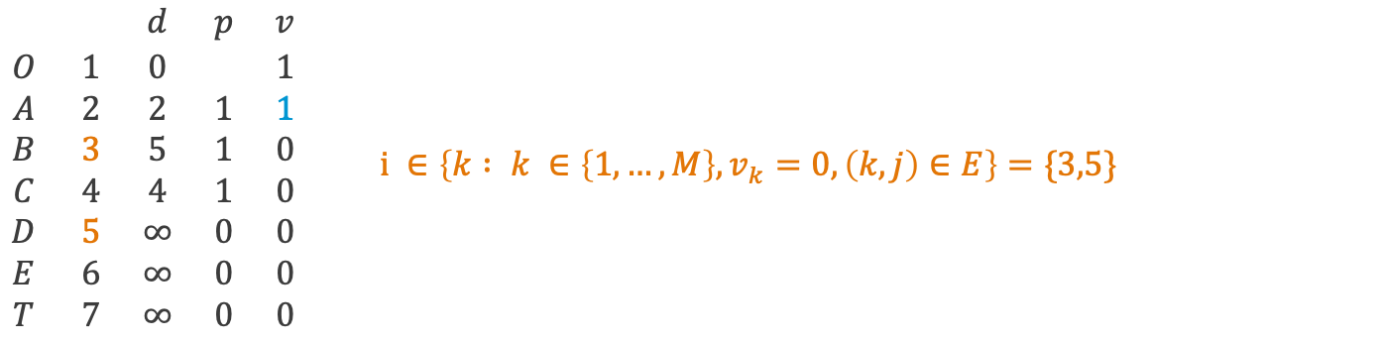
Dijkstra's algorithm – example (step 8)
A
7
2
2
5
T
5
4
B
D
O
1
1
3
7
4
C
3
E
$\begin{matrix} & & d & p & v \\ O & 1 & 0 & & 1 \\ A & 2 & 2 & 1 & 1 \\ B & 3 & 5 & 1 & 0 \\ C & 4 & 4 & 1 & 0 \\ D & 5 & ∞ & 0 & 0 \\ E & 6 & ∞ & 0 & 0 \\ T & 7 & ∞ & 0 & 0\end{matrix}$ $i ∈\left\{k : k ∈\left\{1,…,M\right\},v_{k}=0, \left(k,j\right)∈E\right\}=\{3,5\}$

Slide 37
Dijkstra's algorithm – example (step 9)
A
7
2
2
5
T
5
4
B
D
O
1
1
3
7
4
C
3
E
$\begin{matrix} & & d & p & v \\ O & 1 & 0 & & 1 \\ A & 2 & 2 & 1 & 1 \\ B & 3 & 2+2 & 2 & 0 \\ C & 4 & 4 & 1 & 0 \\ D & 5 & 2+7 & 2 & 0 \\ E & 6 & ∞ & 0 & 0 \\ T & 7 & ∞ & 0 & 0\end{matrix}$ $\begin{matrix}\text{if} d_{j}+w\left(\left(j,i\right)\right)<d_{i} \\ d_{i}= d_{j}+w\left(\left(j,i\right)\right) \\ p_{i}=j\end{matrix}$

Slide 38
Dijkstra's algorithm – example (step 10)
A
7
2
2
5
T
5
4
B
D
O
1
1
3
7
4
C
3
E
$\begin{matrix} & & d & p & v \\ O & 1 & 0 & & 1 \\ A & 2 & 2 & 1 & 1 \\ B & 3 & 4 & 2 & 0 \\ C & 4 & 4 & 1 & 0 \\ D & 5 & 9 & 2 & 0 \\ E & 6 & ∞ & 0 & 0 \\ T & 7 & ∞ & 0 & 0\end{matrix}$ $j∈argmin\left\{d_{k} : k ∈\left\{1,…,M\right\}, v_{k}=0\right\}=\left\{3,4\right\}$

Slide 39
Dijkstra's algorithm – example (step 11)
A
7
2
2
5
T
5
4
B
D
O
1
1
3
7
4
C
3
E
$\begin{matrix} & & d & p & v \\ O & 1 & 0 & & 1 \\ A & 2 & 2 & 1 & 1 \\ B & 3 & 4 & 2 & 1 \\ C & 4 & 4 & 1 & 0 \\ D & 5 & 9 & 2 & 0 \\ E & 6 & ∞ & 0 & 0 \\ T & 7 & ∞ & 0 & 0\end{matrix}$ $\begin{matrix}j∈argmin\left\{d_{k} : k ∈\left\{1,…,M\right\}, v_{k}=0\right\}=\left\{1\right\} \\ v_{j}=1\end{matrix}$

Slide 40
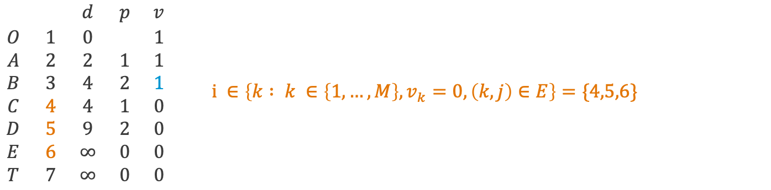
Dijkstra's algorithm – example (step 12)
A
7
2
2
5
T
5
4
B
D
O
1
1
3
7
4
C
3
E
$\begin{matrix} & & d & p & v \\ O & 1 & 0 & & 1 \\ A & 2 & 2 & 1 & 1 \\ B & 3 & 4 & 2 & 1 \\ C & 4 & 4 & 1 & 0 \\ D & 5 & 9 & 2 & 0 \\ E & 6 & ∞ & 0 & 0 \\ T & 7 & ∞ & 0 & 0\end{matrix}$ $i ∈\left\{k : k ∈\left\{1,…,M\right\},v_{k}=0, \left(k,j\right)∈E\right\}=\{4,5,6\}$

Slide 41
Dijkstra's algorithm – example (step 13)
A
7
2
2
5
T
5
4
B
D
O
1
1
3
7
4
C
3
E
$\begin{matrix} & & d & p & v \\ O & 1 & 0 & & 1 \\ A & 2 & 2 & 1 & 1 \\ B & 3 & 4 & 2 & 1 \\ C & 4 & 4 & 1 & 0 \\ D & 5 & 4+4 & 3 & 0 \\ E & 6 & 4+3 & 3 & 0 \\ T & 7 & ∞ & 0 & 0\end{matrix}$ $\begin{matrix}\text{if} d_{j}+w\left(\left(j,i\right)\right)<d_{i} \\ d_{i}= d_{j}+w\left(\left(j,i\right)\right) \\ p_{i}=j\end{matrix}$

Slide 42
Dijkstra's algorithm – example (step 14)
A
7
2
2
5
T
5
4
B
D
O
1
1
3
7
4
C
3
E
$\begin{matrix} & & d & p & v \\ O & 1 & 0 & & 1 \\ A & 2 & 2 & 1 & 1 \\ B & 3 & 4 & 2 & 1 \\ C & 4 & 4 & 1 & 0 \\ D & 5 & 8 & 3 & 0 \\ E & 6 & 7 & 3 & 0 \\ T & 7 & ∞ & 0 & 0\end{matrix}$ $j∈argmin\left\{d_{k} : k ∈\left\{1,…,M\right\}, v_{k}=0\right\}=\left\{4\right\}$

Slide 43
Dijkstra's algorithm – example (step 15)
A
7
2
2
5
T
5
4
B
D
O
1
1
3
7
4
C
3
E
$\begin{matrix} & & d & p & v \\ O & 1 & 0 & & 1 \\ A & 2 & 2 & 1 & 1 \\ B & 3 & 4 & 2 & 1 \\ C & 4 & 4 & 1 & 1 \\ D & 5 & 8 & 3 & 0 \\ E & 6 & 7 & 3 & 0 \\ T & 7 & ∞ & 0 & 0\end{matrix}$ $\begin{matrix}j∈argmin\left\{d_{k} : k ∈\left\{1,…,M\right\}, v_{k}=0\right\}=\left\{4\right\} \\ v_{j}=1\end{matrix}$

Slide 44
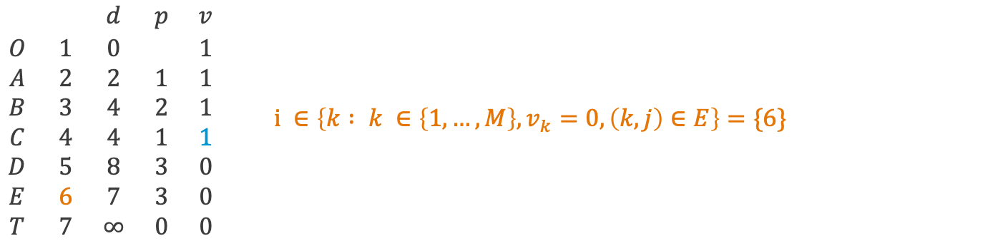
Dijkstra's algorithm – example (step 16)
A
7
2
2
5
T
5
4
B
D
O
1
1
3
7
4
C
3
E
$\begin{matrix} & & d & p & v \\ O & 1 & 0 & & 1 \\ A & 2 & 2 & 1 & 1 \\ B & 3 & 4 & 2 & 1 \\ C & 4 & 4 & 1 & 1 \\ D & 5 & 8 & 3 & 0 \\ E & 6 & 7 & 3 & 0 \\ T & 7 & ∞ & 0 & 0\end{matrix}$ $i ∈\left\{k : k ∈\left\{1,…,M\right\},v_{k}=0, \left(k,j\right)∈E\right\}=\{6\}$

Slide 45
Dijkstra's algorithm – example (step 17)
A
7
2
2
5
T
5
4
B
D
O
1
1
3
7
4
C
3
E
$\begin{matrix} & & d & p & v \\ O & 1 & 0 & & 1 \\ A & 2 & 2 & 1 & 1 \\ B & 3 & 4 & 2 & 1 \\ C & 4 & 4 & 1 & 1 \\ D & 5 & 8 & 3 & 0 \\ E & 6 & 7 & 3 & 0 \\ T & 7 & ∞ & 0 & 0\end{matrix}$ $\begin{matrix}\text{if} d_{j}+w\left(\left(j,i\right)\right)<d_{i} \\ d_{i}= d_{j}+w\left(\left(j,i\right)\right) \\ p_{i}=j\end{matrix}$

Slide 46
Dijkstra's algorithm – example (step 18)
A
7
2
2
5
T
5
4
B
D
O
1
1
3
7
4
C
3
E
$\begin{matrix} & & d & p & v \\ O & 1 & 0 & & 1 \\ A & 2 & 2 & 1 & 1 \\ B & 3 & 4 & 2 & 1 \\ C & 4 & 4 & 1 & 1 \\ D & 5 & 8 & 3 & 0 \\ E & 6 & 7 & 3 & 1 \\ T & 7 & ∞ & 0 & 0\end{matrix}$ $\begin{matrix}j∈argmin\left\{d_{k} : k ∈\left\{1,…,M\right\}, v_{k}=0\right\}=\left\{6\right\} \\ v_{j}=1\end{matrix}$

Slide 47
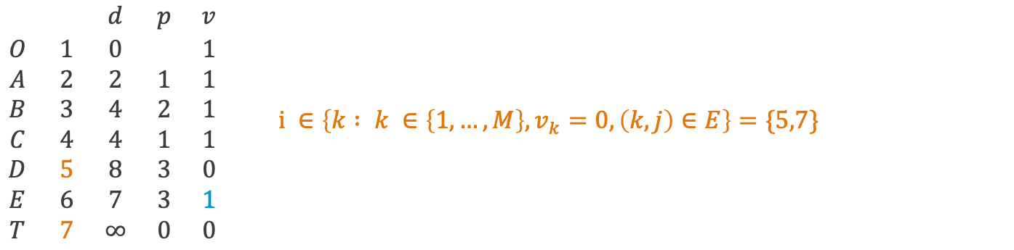
Dijkstra's algorithm – example (step 19)
A
7
2
2
5
T
5
4
B
D
O
1
1
3
7
4
C
3
E
$\begin{matrix} & & d & p & v \\ O & 1 & 0 & & 1 \\ A & 2 & 2 & 1 & 1 \\ B & 3 & 4 & 2 & 1 \\ C & 4 & 4 & 1 & 1 \\ D & 5 & 8 & 3 & 0 \\ E & 6 & 7 & 3 & 1 \\ T & 7 & ∞ & 0 & 0\end{matrix}$ $i ∈\left\{k : k ∈\left\{1,…,M\right\},v_{k}=0, \left(k,j\right)∈E\right\}=\{5,7\}$

Slide 48
Dijkstra's algorithm – example (step 20)
A
7
2
2
5
T
5
4
B
D
O
1
1
3
7
4
C
3
E
$\begin{matrix} & & d & p & v \\ O & 1 & 0 & & 1 \\ A & 2 & 2 & 1 & 1 \\ B & 3 & 4 & 2 & 1 \\ C & 4 & 4 & 1 & 1 \\ D & 5 & 8 & 3 & 0 \\ E & 6 & 7 & 3 & 1 \\ T & 7 & 7+7 & 6 & 0\end{matrix}$ $\begin{matrix}\text{if} d_{j}+w\left(\left(j,i\right)\right)<d_{i} \\ d_{i}= d_{j}+w\left(\left(j,i\right)\right) \\ p_{i}=j\end{matrix}$

Slide 49
Dijkstra's algorithm – example (step 21)
A
7
2
2
5
T
5
4
B
D
O
1
1
3
7
4
C
3
E
$\begin{matrix} & & d & p & v \\ O & 1 & 0 & & 1 \\ A & 2 & 2 & 1 & 1 \\ B & 3 & 4 & 2 & 1 \\ C & 4 & 4 & 1 & 1 \\ D & 5 & 8 & 3 & 1 \\ E & 6 & 7 & 3 & 1 \\ T & 7 & 14 & 6 & 0\end{matrix}$ $\begin{matrix}j∈argmin\left\{d_{k} : k ∈\left\{1,…,M\right\}, v_{k}=0\right\}=\left\{5\right\} \\ v_{j}=1\end{matrix}$

Slide 50
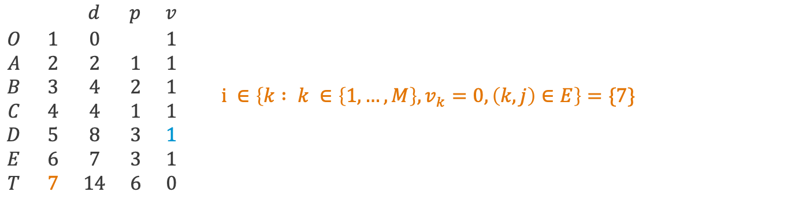
Dijkstra's algorithm – example (step 22)
A
7
2
2
5
T
5
4
B
D
O
1
1
3
7
4
C
3
E
$\begin{matrix} & & d & p & v \\ O & 1 & 0 & & 1 \\ A & 2 & 2 & 1 & 1 \\ B & 3 & 4 & 2 & 1 \\ C & 4 & 4 & 1 & 1 \\ D & 5 & 8 & 3 & 1 \\ E & 6 & 7 & 3 & 1 \\ T & 7 & 14 & 6 & 0\end{matrix}$ $i ∈\left\{k : k ∈\left\{1,…,M\right\},v_{k}=0, \left(k,j\right)∈E\right\}=\{7\}$

Slide 51
Dijkstra's algorithm – example (step 23)
A
7
2
2
5
T
5
4
B
D
O
1
1
3
7
4
C
3
E
$\begin{matrix} & & d & p & v \\ O & 1 & 0 & & 1 \\ A & 2 & 2 & 1 & 1 \\ B & 3 & 4 & 2 & 1 \\ C & 4 & 4 & 1 & 1 \\ D & 5 & 8 & 3 & 1 \\ E & 6 & 7 & 3 & 1 \\ T & 7 & 8+5 & 5 & 0\end{matrix}$ $\begin{matrix}\text{if} d_{j}+w\left(\left(j,i\right)\right)<d_{i} \\ d_{i}= d_{j}+w\left(\left(j,i\right)\right) \\ p_{i}=j\end{matrix}$

Slide 52
Dijkstra's algorithm – example (step 24)
A
7
2
2
5
T
5
4
B
D
O
1
1
3
7
4
C
3
E
$\begin{matrix} & & d & p & v \\ O & 1 & 0 & & 1 \\ A & 2 & 2 & 1 & 1 \\ B & 3 & 4 & 2 & 1 \\ C & 4 & 4 & 1 & 1 \\ D & 5 & 8 & 3 & 1 \\ E & 6 & 7 & 3 & 1 \\ T & 7 & 13 & 5 & 1\end{matrix}$ $\begin{matrix}j∈argmin\left\{d_{k} : k ∈\left\{1,…,M\right\}, v_{k}=0\right\}=\left\{7\right\} \\ v_{j}=1\end{matrix}$

Slide 53
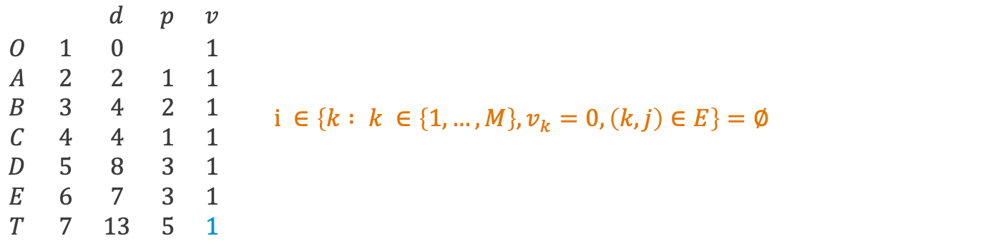
Dijkstra's algorithm – example (step 25)
A
7
2
2
5
T
5
4
B
D
O
1
1
3
7
4
C
3
E
$\begin{matrix} & & d & p & v \\ O & 1 & 0 & & 1 \\ A & 2 & 2 & 1 & 1 \\ B & 3 & 4 & 2 & 1 \\ C & 4 & 4 & 1 & 1 \\ D & 5 & 8 & 3 & 1 \\ E & 6 & 7 & 3 & 1 \\ T & 7 & 13 & 5 & 1\end{matrix}$ $i ∈\left\{k : k ∈\left\{1,…,M\right\},v_{k}=0, \left(k,j\right)∈E\right\}=∅$

Slide 54
Minimal spanning and shortest path trees in Matlab (see OR11_networks.m)

Slide 55
Summary and self-study
Summary: today we have learnt:
about graphs and networks,
how to determine the minimal spanning tree of a network,
how to determine the shortest path tree of a network.
Self-study: Find the minimal spanning tree
and the shortest path tree starting at node O
of the network on the right.

